Slide 1



vs
Python vs Ruby
ARRAY SHUFFLE PROBLEM
CSE 451: Concepts of Programming Languages

Slide 2



The Problem
Output
Input
Shuffle string so character at position i moves to indices[i].
Given a string s and an integer array indices of the same length.
'a' (idx 0) → idx 1 'r' (idx 1) → idx 0 't' (idx 2) → idx 2

Slide 3


Algorithm Step-by-Step
▹
Initialize: Create an empty result array of size N.
▹
Iterate: Loop through the input string with index i.
▹
Place: Assign result[indices[i]] = s[i].
▹
Join: Convert the result array back into a string.
Complexity: O(N) Time | O(N) Space

Slide 4


Python
The "Batteries Included" Language
▹
Created: 1991 by Guido van Rossum.
▹
Philosophy: "There should be one-- and preferably only one --obvious way to do it."
▹
Key Traits: Dynamic typing, huge ecosystem (pip), explicit syntax.
▹
Uses: AI/ML, Data Science, Web (Django), Scripting.

Slide 5
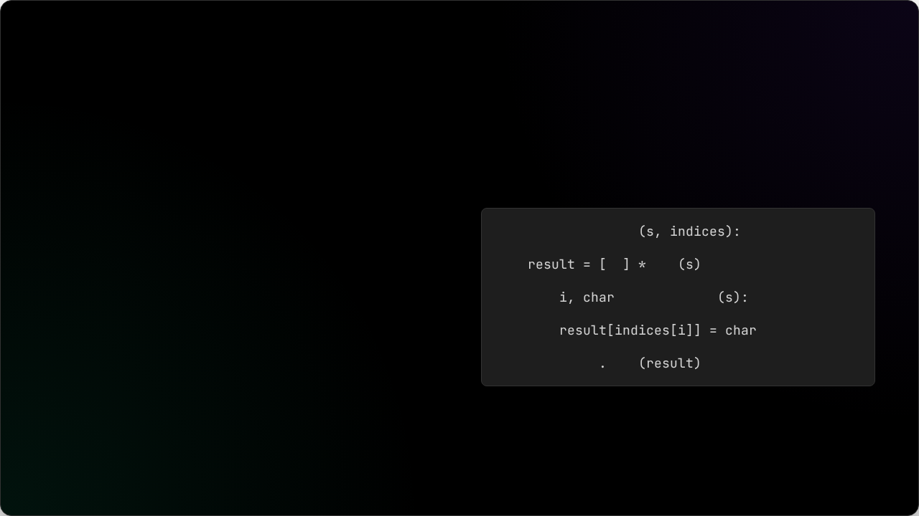
Python Implementation
Key Features
def
shuffle_string
# Create empty list of size N
▹
enumerate(s) gives us both index and character.
''
len
▹
List initialization: [''] * len(s) is idiomatic.
for
in
enumerate
# Map current char to target index
▹
''.join() is the standard way to build strings.
return
''
join

Slide 6

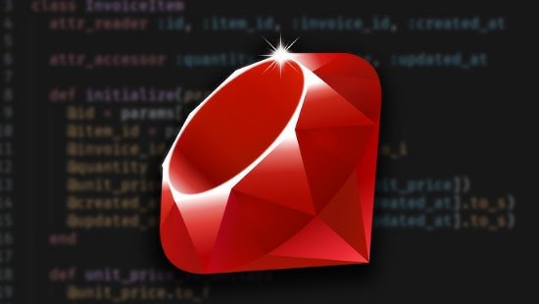
Ruby
"Developer Happiness"
▹
Created: 1995 by Yukihiro "Matz" Matsumoto.
▹
Philosophy: "Optimize for programmer happiness."
▹
Key Traits: Pure OOP (everything is an object), flexible syntax (TIMTOWTDI), blocks.
▹
Uses: Web Dev (Ruby on Rails), DevOps (Puppet/Chef).

Slide 7
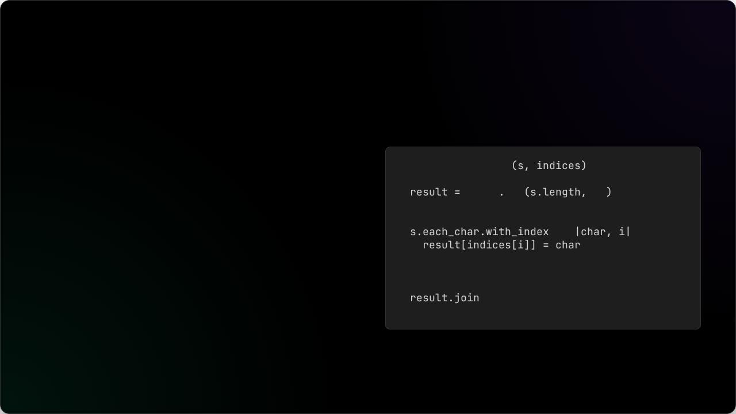
Ruby Implementation
Key Features
def
shuffle_string
# Initialize array with defaults
▹
Array.new creates the structure.
Array
new
''
▹
each_char.with_index chains enumerators elegantly.
# Iterate with index
do
▹
Block Syntax: do |char, i| ... end is central to Ruby.
end
# Implicit return
▹
Implicit return (last line returns).
end

Slide 8
Feature Comparison
Feature | Python | Ruby
Type System | Dynamic, Strong | Dynamic, Duck Typing
Array Init | [''] * len(s) | Array.new(n, '')
Iteration | enumerate(s) | s.each_char.with_index
Block Syntax | Indentation (whitespace) | do/end or { }
String Join | ''.join(list) | array.join

Slide 9






Challenges & Learnings
Environment Setup
Syntax Curve
Verification
Installing Ruby on Windows required the RubyInstaller and DevKit configuration to manage native extensions.
Adapting to Ruby's block syntax and method chaining (e.g., .with_index) was a shift from Python's direct style.
Ensuring both implementations produced identical output for edge cases (empty strings, single characters).

Slide 10
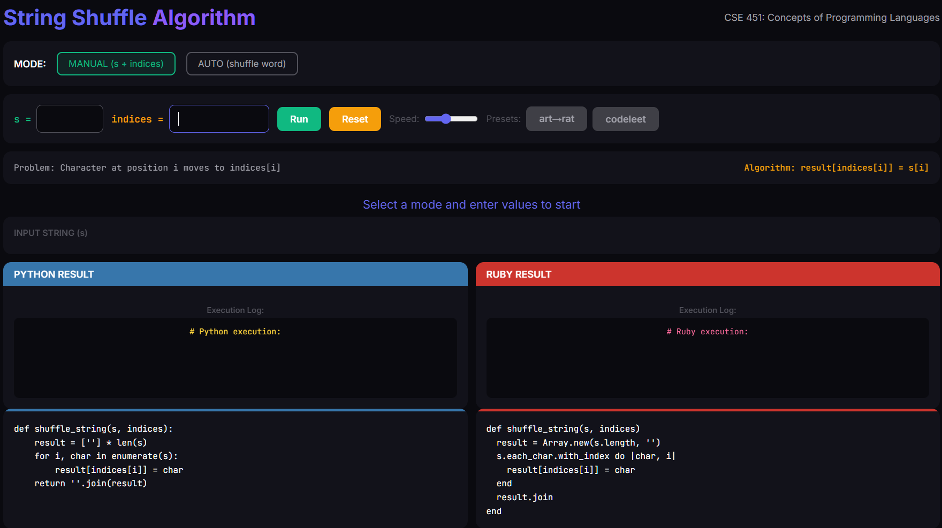


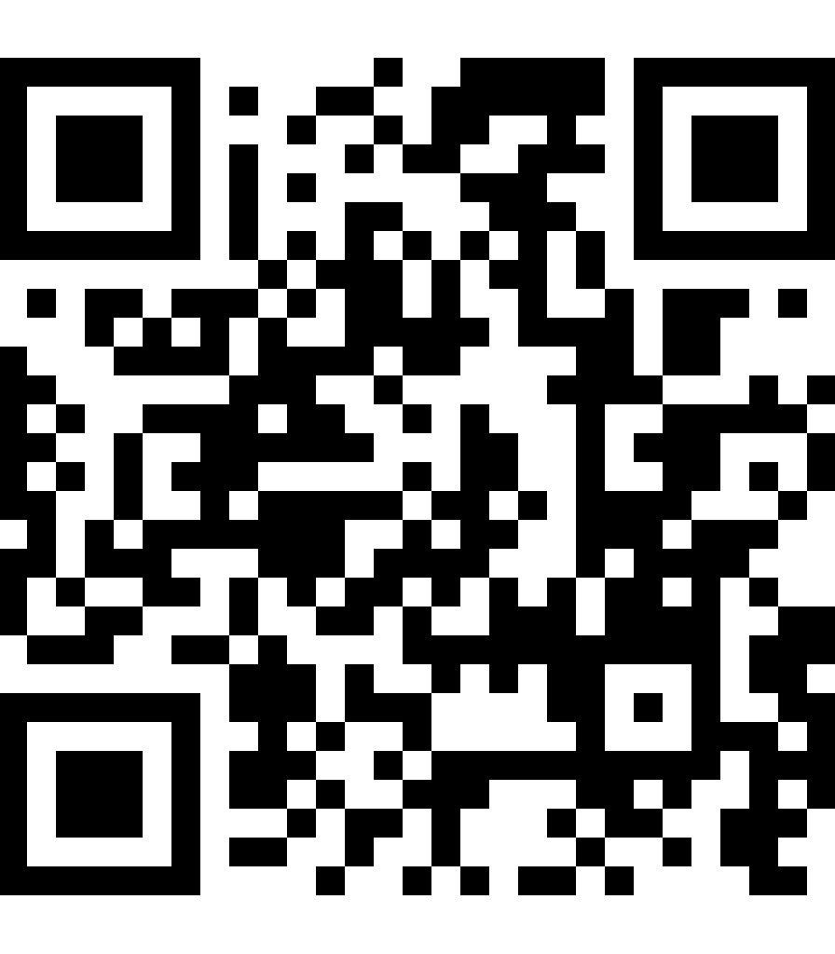
Live Demo
Try the App Yourself !
Scan to see the algorithm in action.
https://mvvhmxd.github.io/Python-vs-Ruby

Slide 11
Key Takeaway
"Understanding the concepts (arrays, indices, complexity) matters more than the syntax."
Questions?
Thank you for listening.

Slide 12




Image Sources
▹
https://img.freepik.com/premium-vector/set-abstract-colorful-spheres-from-points-lines-dark-background-network-connection-structure-big-data-visualization-vector-illustration_634443-1804.jpg
Source: www.freepik.com
▹
https://4kwallpapers.com/images/wallpapers/python-logo-dark-2880x1800-16094.png
Source: 4kwallpapers.com
▹
https://i.ytimg.com/vi/vXV6Ahqw0Sk/hq720.jpg?sqp=-oaymwEhCK4FEIIDSFryq4qpAxMIARUAAAAAGAElAADIQj0AgKJD&rs=AOn4CLCYT3rxW-go1QJhrdcJ36MFtfaaLA
Source: www.youtube.com
▹
https://res.cloudinary.com/practicaldev/image/fetch/s--rUTLfE4---/c_limit%2Cf_auto%2Cfl_progressive%2Cq_auto%2Cw_880/https://dev-to-uploads.s3.amazonaws.com/i/jrxbe5fpuuk6mgchng1m.png
Source: dev.to

